Slide 1
ThoracIc out let Syndrome

Slide 2
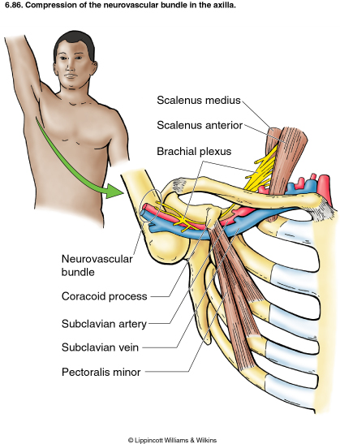
)

Slide 3
(419 × 547 pixels, file size: 139 KB, MIME type: image/jpeg)

Slide 4
TOS.The thoracic outlet comprises the space from the supraclavicular fossa to the axilla.
The thoracic outlet is defined as the space in the lower neck between the thorax and axilla through which the subclavian vein, subclavian artery, and brachial plexus travel from their central origins to their peripheral termini.
It is bounded by the clavicle anteriorly, the first thoracic rib posteriorly, the insertion of the pectoralis minor muscle onto the coracoid process of the humerus laterally, and the sternum medily.
It is subdivided into three areas: the scalene triangle above the clavicle, the costoclavicular space or cervicoaxillary canal between the clavicle and first rib, and the subcoracoid or pectoralis minor space below the clavicle1,2 (Fig. 1).

Slide 5
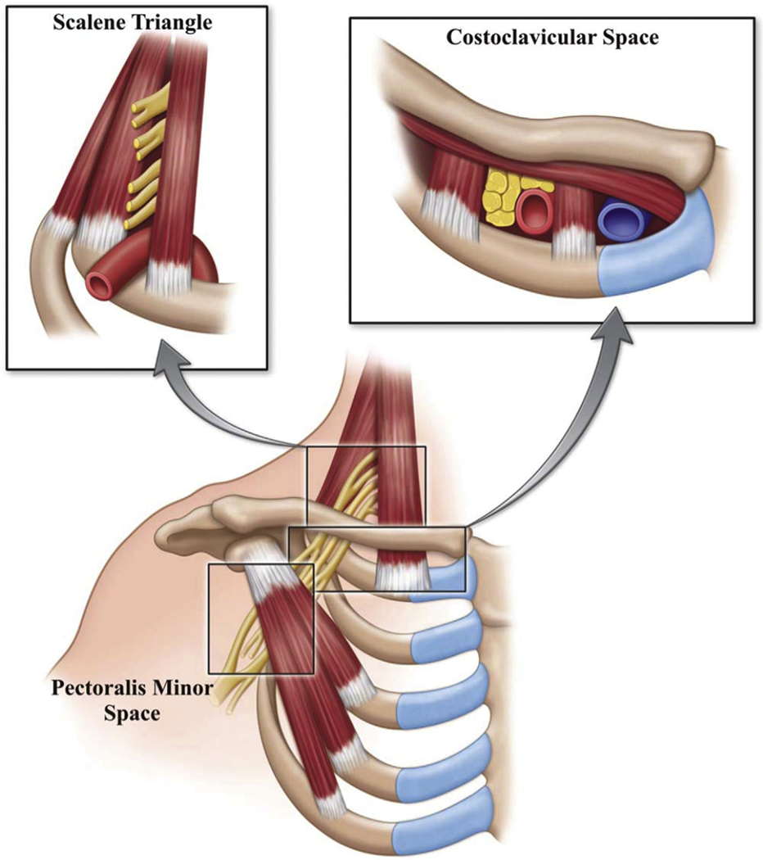

Slide 6
Three spaces of the thoracic outlet. (From Klaassen Z, Sorenson E, Tubbs RS, et al. Thoracic outlet Esyndrome: a neurological and vascular disorder. Clin Anat. 2014;27:724–32; with permission)

Slide 7
The subclavian vasculature and brachial plexus—together termed the neurovascular bundle—pass from the scalene triangle into the costoclavicular space before exiting through the subcoracoid space. The thoracic outlet is both a confined and a dynamic space: compression of the neurovascular bundle resulting in the clinical syndrome generally termed thoracic outlet syndrome (TOS) may occur constantly or intermittently with movement of the neck, thorax, and arm (Fig. 2)

Slide 8
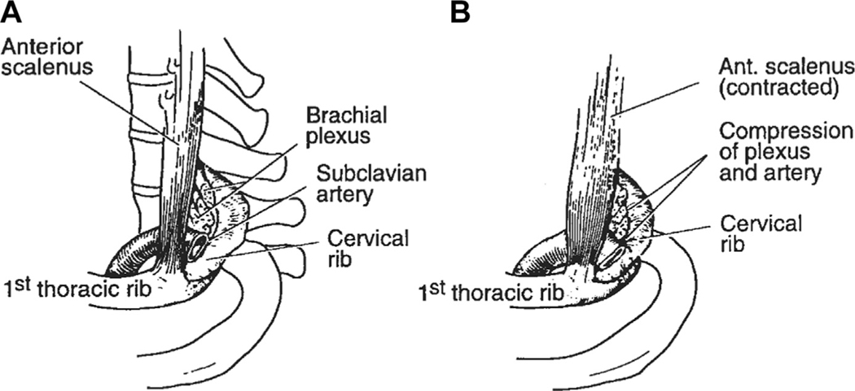

Slide 9
Figure, may constrict this space further. (From Adson AW. Surgical treatment for symptoms produced by cervical ribs and the scalenus anticus muscle. Surg Gynecol Obstet. 1947;85:687. Reprinted with permission from the Journal of the American College of Surgeons, formerly Surgery Gynecology & Obstetrics.)
Table1anatomic space thoracic out let

Slide 10
Table1of thoracic outlet syndrome Anatomic spaces
Compartment | Borders | Content
Interscalene triangle | Anterior: anterior scalene muscle Posterior: middle scalene muscle Inferior: first rib | Brachial pleux Subclavian artery
Costoclavicular space | Anterior supclavius muscle Inferior posterior: First rib and anterior scalene muscle Superior: clavicle | Brachial Pleux Subclavian Artery Subclavian vein
Subcoracoid space | Anterior: pectoralis minor muscle Posterior:rib2-4 Superior: coracoid | Brachial plexus Axillary artery Axillary vein

Slide 11
The median nerve is derived from the medial and lateral cords of the brachial plexus. It contains fibres from roots C6-T1 and can contain fibres from C5 in some individuals.
After originating from the brachial plexus in the axilla, the median nerve descends down the arm, initially lateral to the brachial artery. Halfway down the arm, the nerve crosses over the brachial artery, and becomes situated medially. The median nerve enters the anterior compartment of the forearm via the cubital fossa.
In the forearm, the nerve travels between the flexor digitorum profundus and flexor digitorum superficialis muscles. The median nerve gives off two major branches in the forearm:

Slide 13
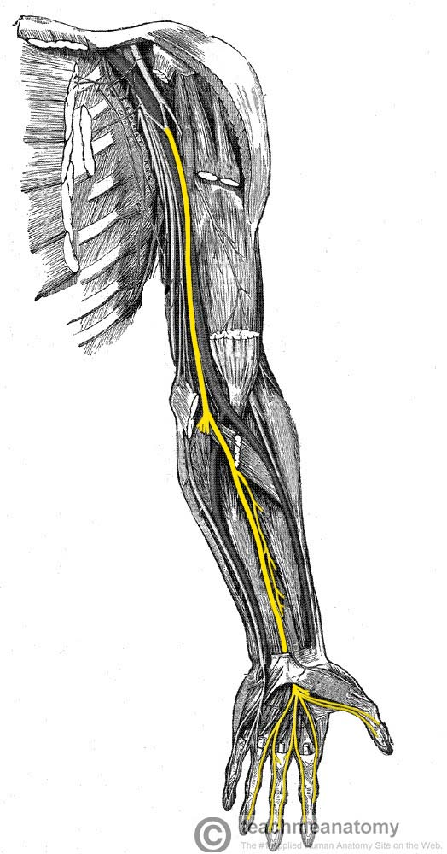
Fig1-anatomical branches of the median nerve through the upper limp

Slide 14
Motor Functions
The median nerve innervates the majority of the muscles in the anterior forearm, and some intrinsic hand muscles.
Anterior Forearm
In the forearm, the median nerve directly innervates muscles in the superficial and intermediate layers:
Superficial layer – pronator teres, flexor carpi radialis and palmaris longus.
Intermediate layer – flexor digitorum superficialis.
The median nerve also gives rise to the anterior interosseous nerve, which supplies the deep flexors:
Deep layer – flexor pollicis longus, pronator quadratus, and the lateral half of the flexor digitorum profundus (the medial half of the muscle is innervated by the ulnar nerve).
In general, these muscles perform pronation of the forearm, flexion of the wrist and flexion of the digits of theHand

Slide 15
Hand
The median nerve innervates some of the muscles in the hand via two branches.
The recurrent branch of the median nerve innervates the thenar muscles – muscles associated with movements of the thumb. The palmar digital branch innervates the lateral two lumbricals – these muscles perform flexion at the metacarpophalangeal joints and extension at the interphalangeal joints of the index and middle fingers
(The remaining muscles in the anterior forearm and hand are innervated by the ulnar nerve).

Slide 16
Sensory Functions
The median nerve is responsible for the cutaneous innervation of part of the hand. This is achieved via two branches:
Palmar cutaneous branch – arises in the forearm and travels into the hand. It innervates the lateral aspect of the palm. This nerve does not pass through the carpal tunnel, and is spared in carpal tunnel syndrome.
Palmar digital cutaneous branch – arises in the hand. Innervates the palmar surface and fingertips of the lateral three and half digits.

Slide 17
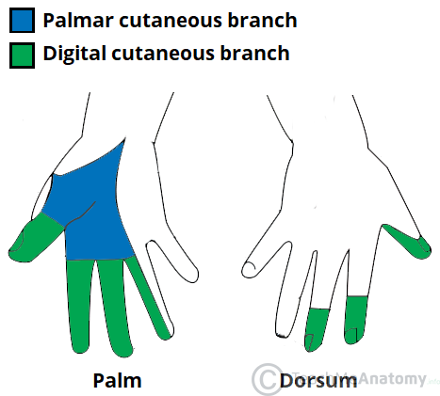
Cutaneous innervation of the branches of the median nerve

Slide 18
Etiology of thoracic outlet syndrome

Slide 19
Bone anomalis
1-extra rib or cervical rib
( elongated of transverse process of C7 )
2- an old fracture in clavicle ( malunion of clavicle fracture)
3-poor body alignment (drop shoulder)

Slide 20
Soft tissue anomalis
4-scar tissue
5- hypertrophy of anterior sclenai and pectoralis minor muscles
6- obesity
7- pregnancy

Slide 21
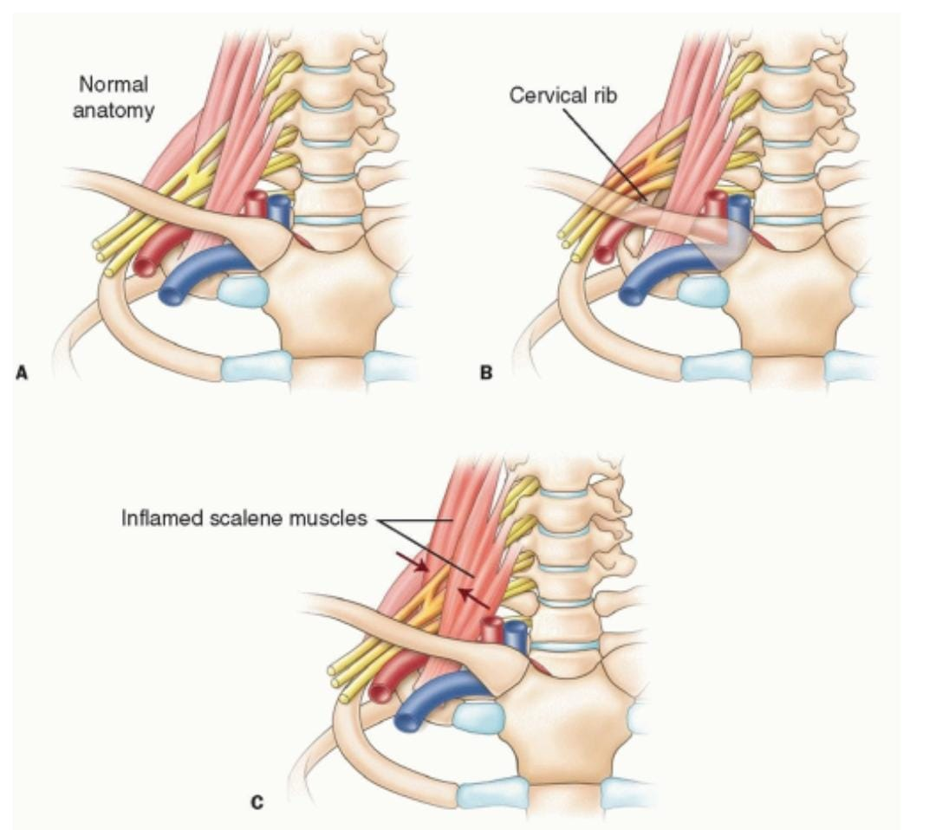
1-cervical rib

Slide 22
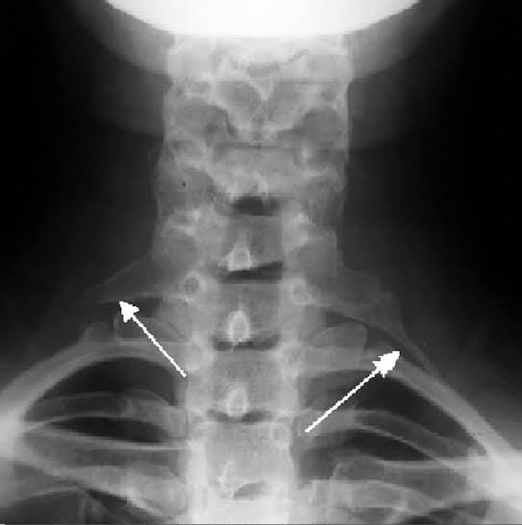
extra rib (congenital )

Slide 23
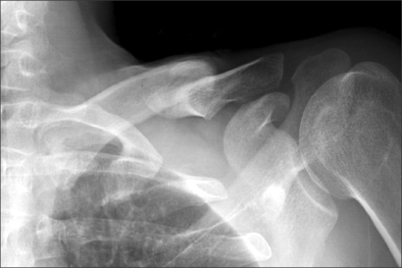
3-an old fracture of the clavicle

Slide 24
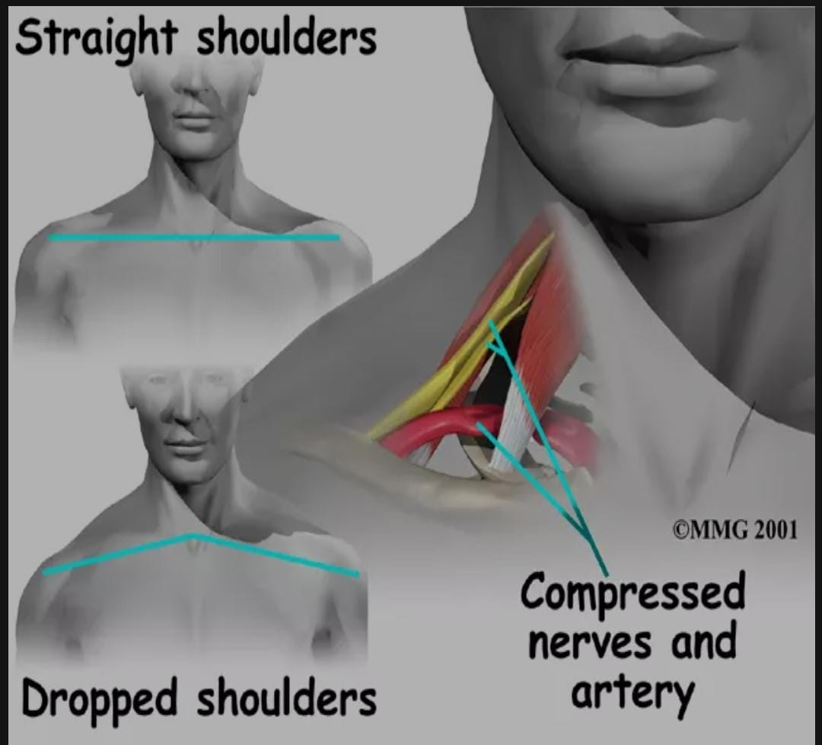
4-Poor body alignment (drop shoulder)

Slide 25
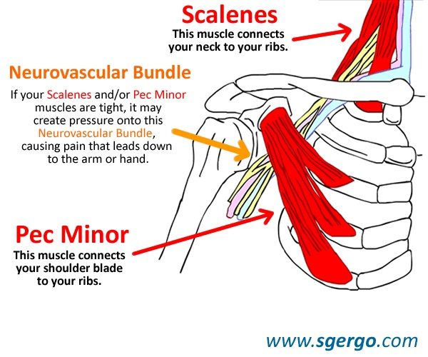
Hypertrophy of the anterior and middle scalene

Slide 26
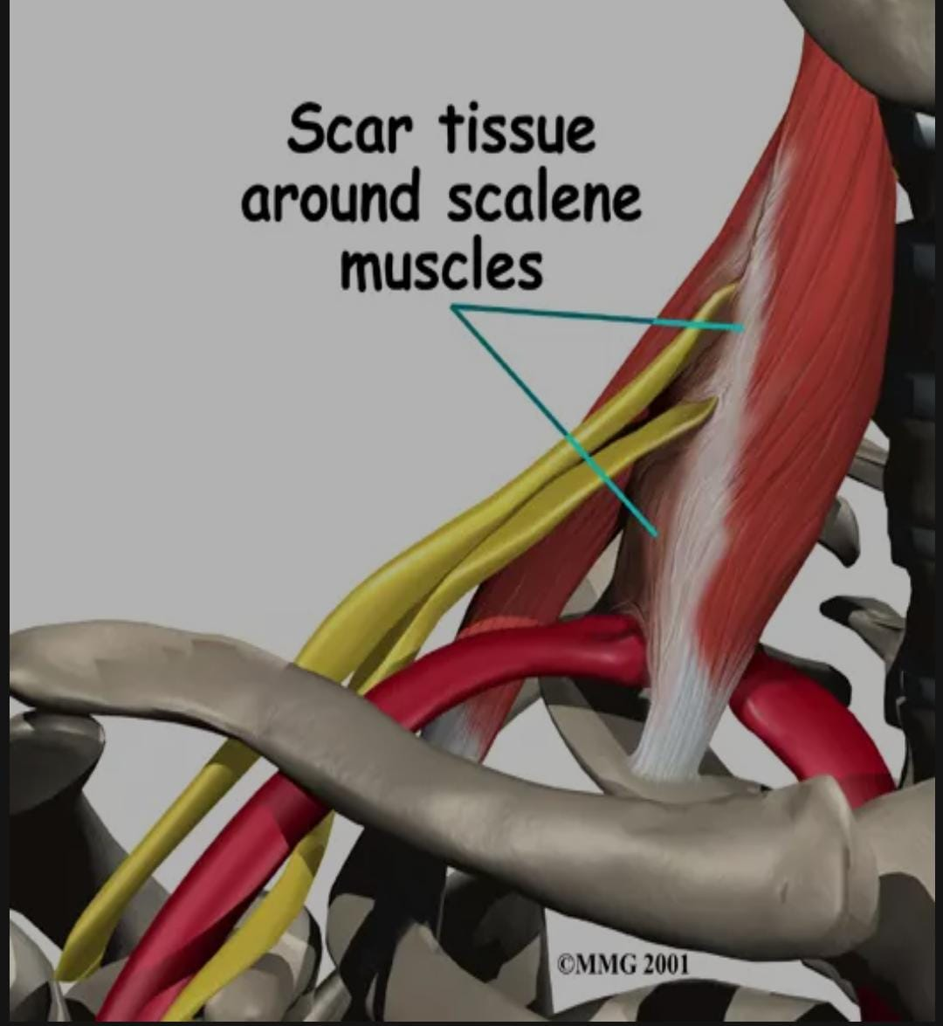
5-Scar tissue

Slide 27
INVESTIGATION …
To confirm the diagnosis of thoracic outlet syndrome, your doctor may order one or more of the following tests:
1- Ultrasound:
An ultrasound uses sound waves to create images of your body. It's often the first imaging test used to help diagnose thoracic outlet syndrome. Doctors may use this test to see if you have vascular thoracic outlet syndrome or other vascular problems.

Slide 28
2-X-ray: Doctor may order a chest X-ray, which may reveal an extra rib (cervical rib). X-rays can also help to rule out other conditions that could be causing your symptoms.
3-Computerized tomography (CT) scan :
. A CT scan uses X-rays to obtain cross-sectional images of your body. A dye may be injected into a vein to view the blood vessels in greater detail (CT angiography). A CT scan may identify the location and cause of blood vessel (vascular) compression.

Slide 29
4- Magnetic resonance imaging (MRI): An MRI uses powerful radio waves and magnets to create a detailed view of your body. Your doctor may use an MRI to determine the location and cause of blood vessel (vascular) compression, sometimes along with an injected dye to better see the blood vessels. An MRI may reveal congenital anomalies, such as a fibrous band connecting your spine to your rib or a cervical rib, which may be the cause of your symptoms. It may be used while your doctor places your head, shoulders and neck in different positions for a better view of the blood vessels in your arm.
5- Electromyography (EMG) :
During an EMG, your doctor inserts a needle electrode through your skin into various muscles. The test evaluates the electrical activity of your muscles when they contract and when they're at rest. This test can determine if you have nerve damage.

Slide 30
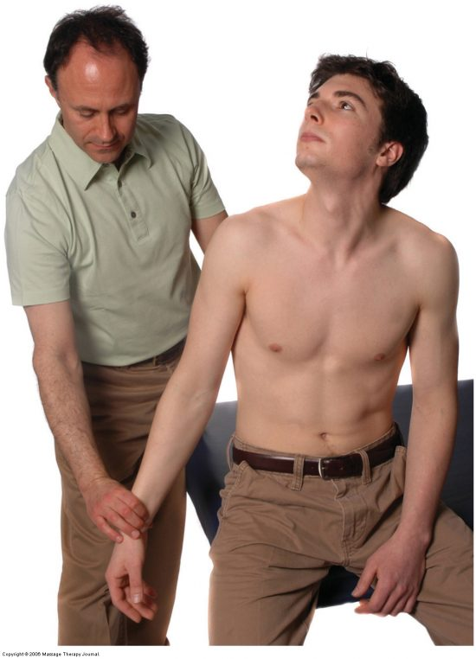
Adson’s Test : Adson’s test is designed to assess anterior scalene syndrome, one of the four forms of thoracic outlet syndrome. Given that anterior scalene syndrome is a neurovascular entrapment syndrome caused by tight anterior and middle scalenes, the idea is to stretch and pull these muscles taut, causing them to further compress the brachial plexus and subclavian artery, which run between them. Adson’s test involves asking the client to rotate the neck ipsilaterally, flex it laterally to the opposite side, and extend the neck at the spinal joints (the opposite actions of the actions of the anterior and middle scalenes), while the therapist is palpating the radial puls

Slide 31
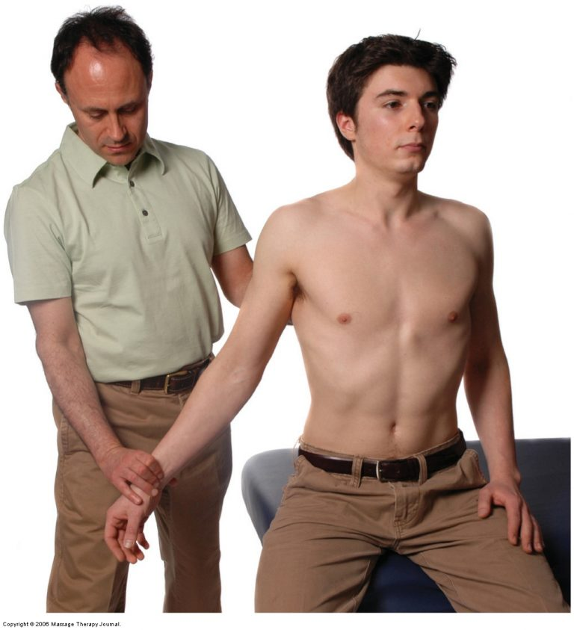
Eden’s Test
Eden’s test is designed to assess for costoclavicular syndrome, another one of the four forms of thoracic outlet syndrome. Costoclavicular syndrome is a neurovascular entrapment syndrome caused by a decrease of the costoclavicular space between the first rib (“cost” means rib) and clavicle. Eden’s test further decreases this space by bringing the clavicle and first rib closer together, causing further compression of the brachial plexus and the subclavian artery and vein, which run through this space. Eden’s test involves asking the client to push out the chest and pull the shoulder girdles back, as if assuming a military position of attention, while the therapist palpates the strength of the radial pulse (Fig. 12). Pushing the chest out brings the first rib forward, while pulling the shoulder girdles back brings the clavicle back, thereby decreasing the space between them.
Eden’s test is also known as the military brace test.

Slide 32
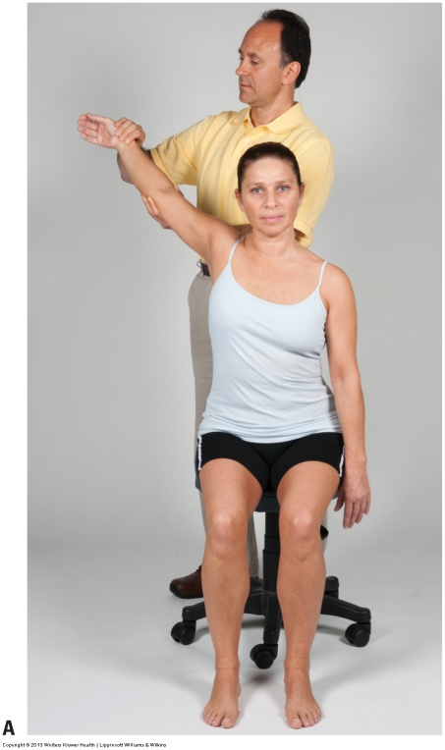
Wright’s Test
Wright’s test is designed to assess pectoralis minor syndrome, another one of the four forms of thoracic outlet syndrome. Given that pectoralis minor syndrome is a neurovascular entrapment syndrome caused by a tight pectoralis minor, the idea is to stretch and pull this muscle taut, causing it to further compress the brachial plexus and the subclavian/axillary artery and vein that run between it and the ribcage. Wright’s test involves bringing the client’s upper extremity back into abduction and extension while the therapist palpates the strength of the radial pulse

Slide 33
Treatment ..
in most cases, a conservative approach to treatment may be most effective especially if your condition is diagnosed early.
Treatment mayinclude:Z

Slide 34
PHYSICAL THERAPY….
Is the first line of treatment , included :
Pain relife
ROM
exercises
Muscle strength
Manual therapy
1-TENS.
2-U.S.
3-ICE.
Median nerve gliding .& stretches
Erercises may take pressure of the nerve
Strength the shoulder muscles

Slide 35
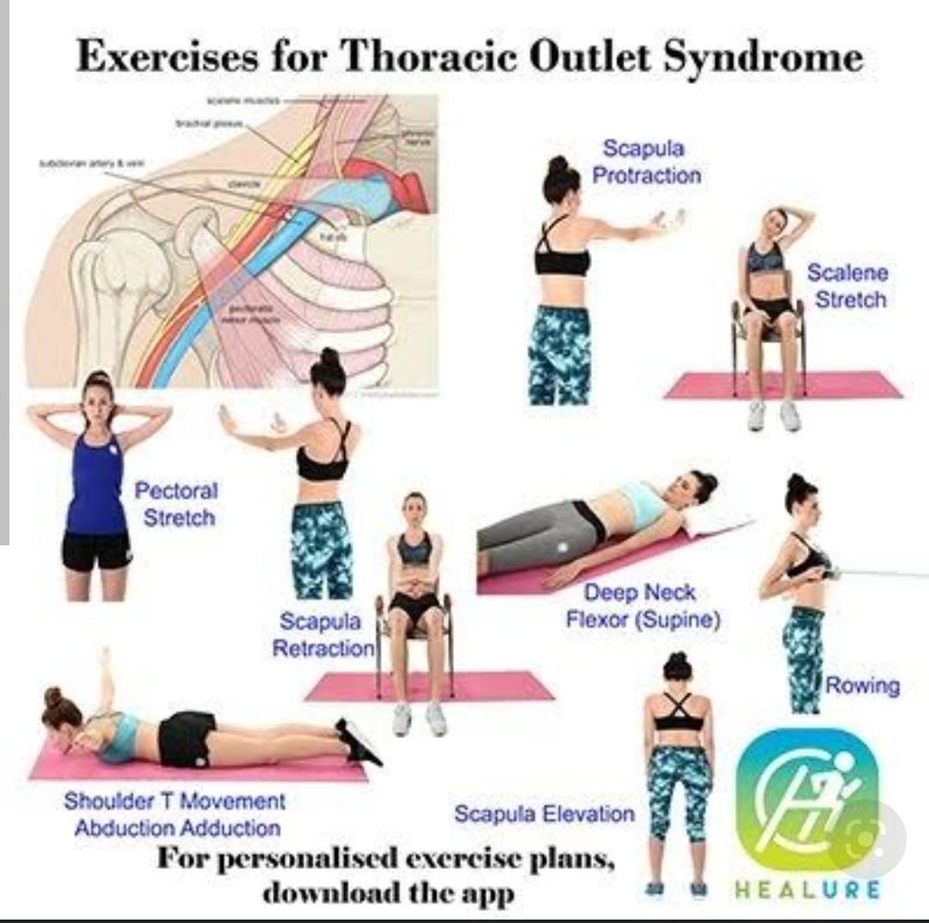
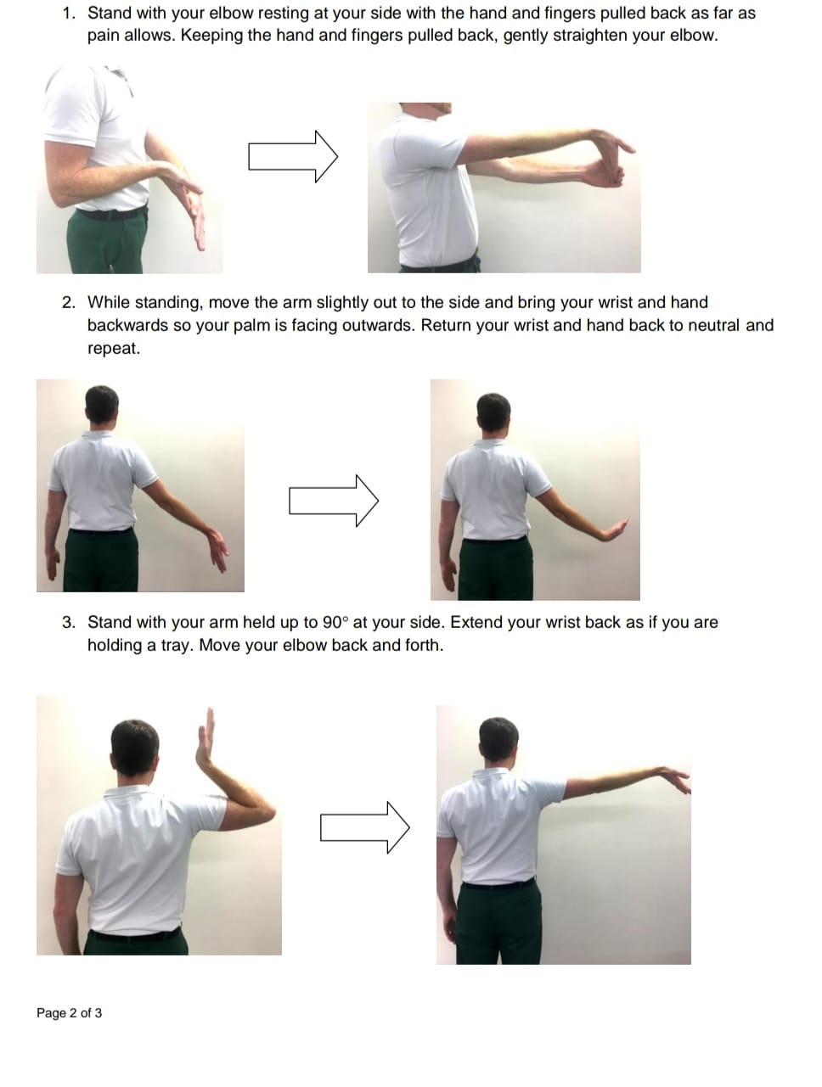

Slide 36
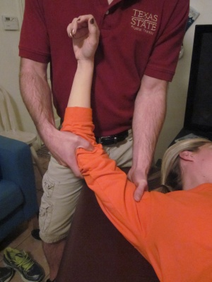
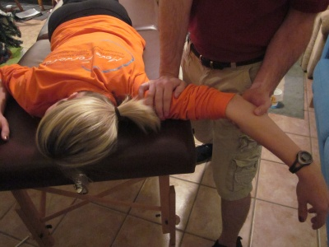
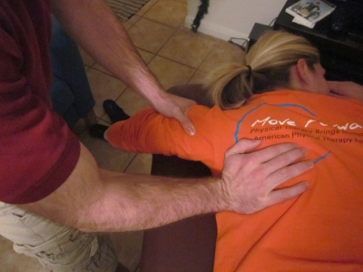

Slide 37
2-Medications..
Anti-inflammatory medications, pain medications or muscle relaxants to decrease inflammation, reduce pain and encourage muscle relaxation. If there is a blood clot, your doctor may prescribe a blood-thinning medication.
3-Clot-dissolving medications..
If you have venous or arterial thoracic outlet syndrome and have blood clots, your doctor may administer clot-dissolving medications (thrombolytics) into your veins or arteries to dissolve blood clots. After you're given thrombolytics, your doctor may prescribe medications to prevent blood clots (anticoagulants).

Slide 38
Surgical options…
doctor may recommend surgery if conservative treatments haven't been effective, if you're experiencing ongoing or worsening symptoms, or if you have progressive neurological problemThoracic outlet syndrome surgery has risks of complications, such as injury to the brachial plexus. Also, surgery may not relieve your symptoms, and symptoms may recur.

Slide 39
Lifestyle and home remedies
If you're diagnosed with thoracic outlet syndrome, your doctor or physical therapist will instruct you to do exercises at home to strengthen and support the muscles surrounding your thoracic outlet.
In general, to avoid unnecessary stress on your shoulders and muscles surrounding the thoracic outlet:
Maintain good posture
Take frequent breaks at work to move and stretch
Maintain a healthy weight
Create a work area that allows you to keep good posture and doesn't make symptoms worse
Gently massage your shoulders and thoracic outlet
Apply a heating pad to the area
Practice relaxation exercises such as deep breathing, meditation and stretching

Slide 40
QUESTIONS … MCQ:
1-Thorax out let is bounded by the clavicle
Anteriorly
Posteriorly
Medialy
Laterally
2-Median nerve contain fiber from :
C8t
1-c5
C5,6
3-Thoracic out let is bounded by the sternum :
Anteriorly
Posteriorly
Medialy
Laterally

Slide 41
4- The following causes of TOS are bony except : a-fracture clavicle b- extra rib c- pregnancy 5- Which muscle is caused TOS when it hypertrophied : a-anti sclenai b- pectoralis major c- deltoid
TRUE OR FALSE :
1- compresion on median nerve lead to TOS ( T )
2-Life style isnot important to patient with ToS ( F )
3- Compresion of the subclavian artery is used as indicator of brachial plexus compression (t).
4-adsons test is designed toassess pectoralis minor (f).

